Slide 1

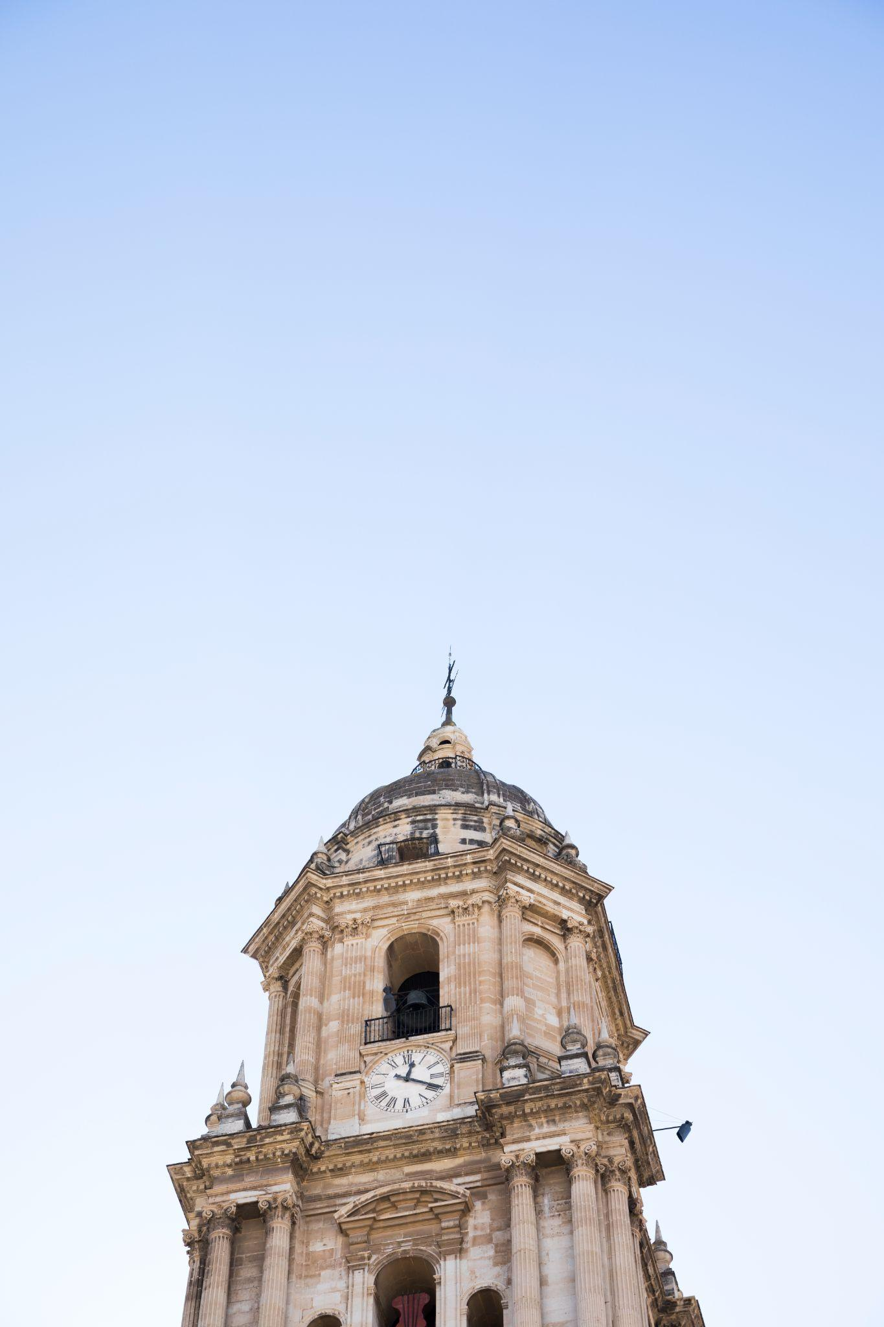

Travel & Stay We take you places
Group 3- Travel and Tourism Management

Slide 2
Table of contents
01
02
03
04
05
06
Introduction
Business Rules
ERD
Data Dictionary
SQL Query
DEMO

Slide 3
01
INTRODUCTION

Slide 4
Introduction
Travel and Stay is a web-based platform that simplifies travel planning by offering integrated booking services for both transportation and accommodations. It boosts user convenience and efficiency through a unified interface, powered by a robust and scalable database alongside an interactive frontend.
It includes two main types of users: Travelers: Individuals booking tours, accommodations, or transportation online. Travel Admins: Staff or operators managing tour packages, bookings, and customer support.
The technology stack includes PHP, HTML, CSS, JavaScript,Ajax, Visual Studio Code, MySQL Server & Database, and XAMPP.

Slide 5
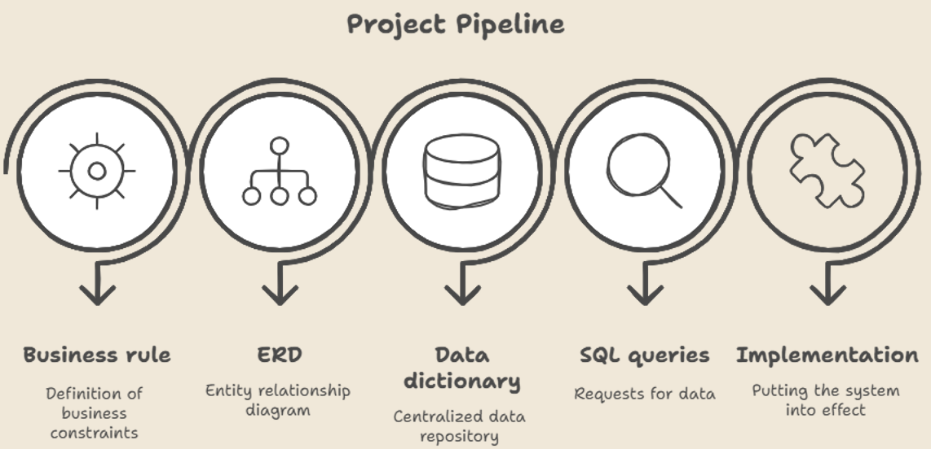

Slide 6
02
BUSINESS RULE

Slide 7
(1,M)
TOUR_ORDER
A user may have zero or many booking orders for tour, flight and rooms.
A user must have an active status to book.
(1,M)
USERS
FLIGHT_ORDER
(1,M)
BOOKING_ORDER

Slide 8
(M,1)
(1,M)
TOUR_PACKAGE
PACKAGE_IMAGES
A package can have zero or many orders.
An order belongs to only one tour package.
A tour order has one invoice.
A package have multiple images.
An order have only one tour booking detail referencing the package detail at time of booking.
A tour order have zero or one review which can be submitted after tour is completed.
(1,1)
TOUR_ORDER
TOUR_BOOKING_DETAIL
(1,1)
TOUR_RATING_REVEWS

Slide 9
(M,1)
FLIGHTS
A flight can have zero or many flight booking.
A flight booking belongs to only one flight.
A flight order has one invoice.
A flight order have only one flight booking detail referencing the package detail at time of booking.
A flight order have zero or one review which can be submitted after flight has arrived to its destination.
(1,1)
FLIGHT_ORDER
FLIGHT_BOOKING_DETAIL
(1,1)
FLIGHT_RATING_REVEWS

Slide 10
(M,1)
ROOMS
A room can have zero or many room booking.
A room booking order belongs to only one room.
A booking order has one invoice per booking.
A booking order have only one booking detail referencing the room booking details at time of booking.
A booking order have zero or one review which can be submitted after guest has checked out from the room.
(1,1)
BOOKING_ORDER
BOOKING_DETAILS
(1,1)
RATING_REVEWS

Slide 11
(M,N)
FACILITIES
ROOM_FACILITIES
(M,N)
ROOMS
FEATURES
ROOM_FEATURES
A room have many facilities, and a facility belongs to many rooms.
A room have many features, and a feature belongs to many rooms.
A room have multiple images.
A room have zero or many reviews
(1,1)
ROOM_IMAGES
(1,M)
RATING_REVIEW

Slide 12
03
ENTITY RELATIONSHIP DIAGRAM

Slide 13
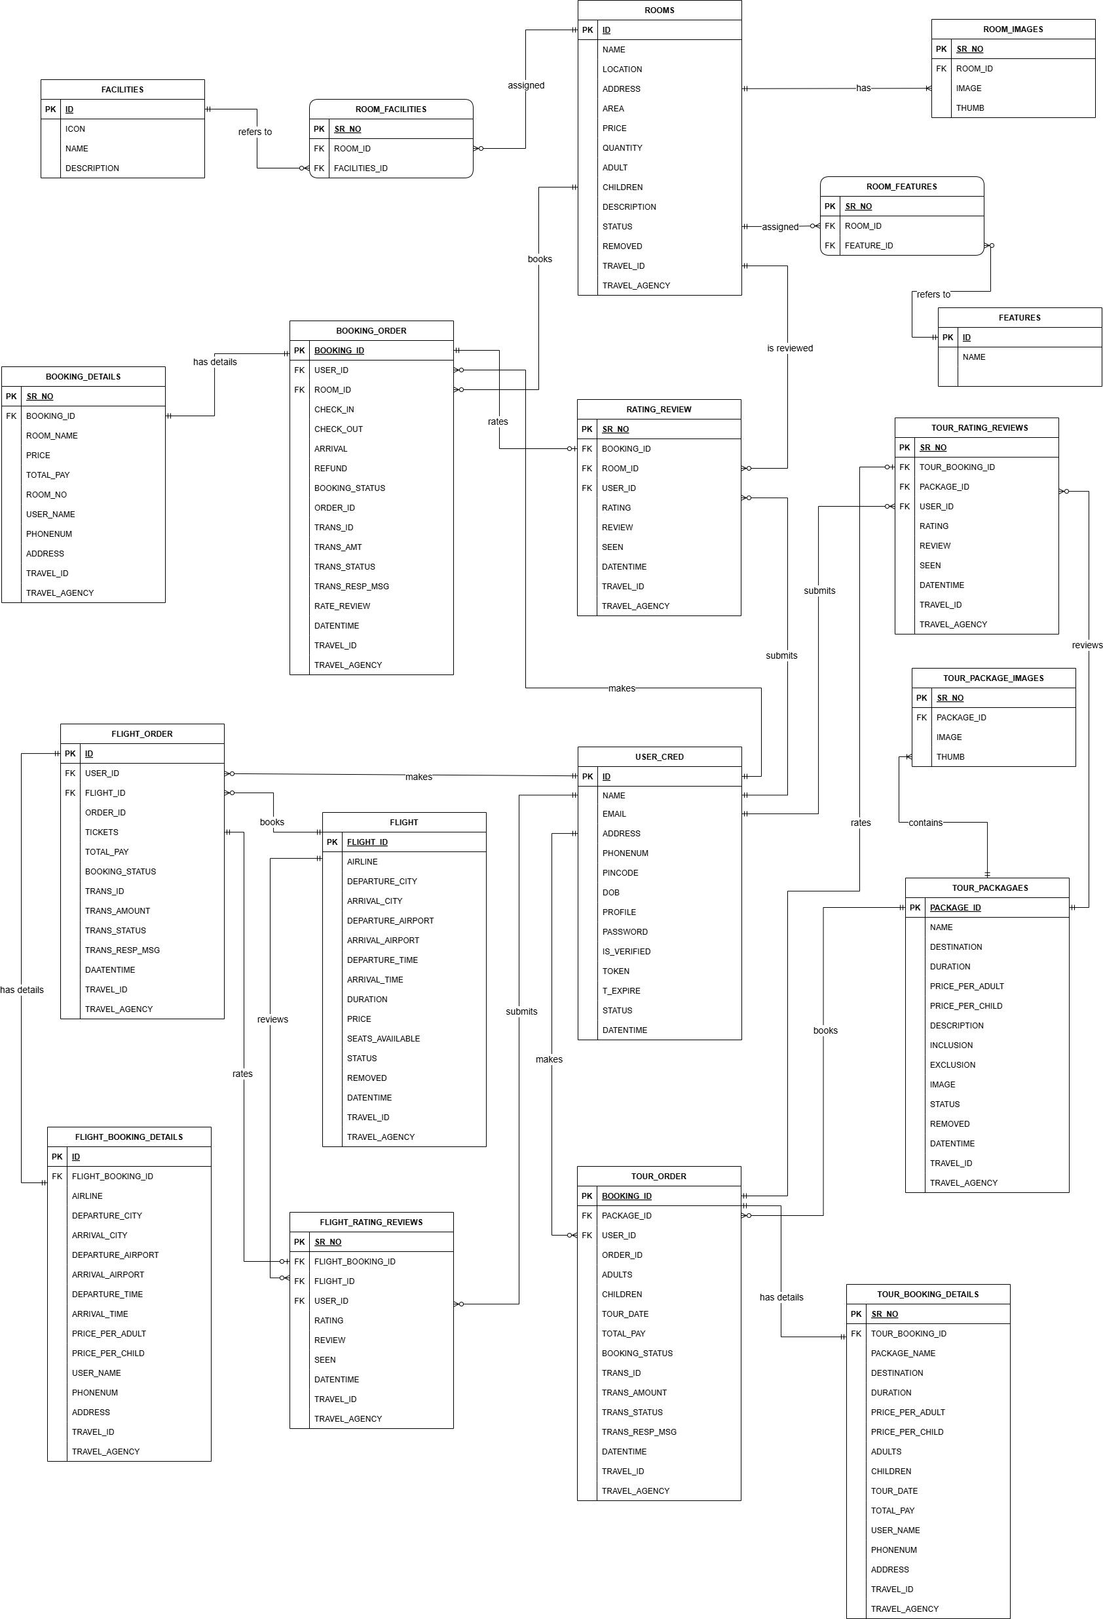

Slide 14
04
ENTITES AND DATA DICTIONARY

Slide 15
DATA DICTIONARY
ENTITY | ATTRIBUTE | DATA TYPE | KEY TYPE
BOOKING_DETAILS | SR_NO | INT | PRIMARY KEY
 | BOOKING_ID | VARCHAR | FOREIGN KEY
 | ROOM_NAME | VARCHAR
 | PRICE | INT
 | TOTAL_PAY | INT
 | ROOM_NO | VARCHAR
 | USER_NAME | VARCHAR
 | PHONENUM | VARCHAR
 | ADDRESS | VARCHAR
 | TRAVEL_ID | INT
 | TRAVEL_AGENCY | VARCHAR
FACILITIES | ID | INT | PRIMARY KEY
 | ICON | VARCHAR

Slide 16
 | NAME | VARCHAR
 | DESCRIPTION | VARCHAR
FLIGHT_ORDER | ID | INT | PRIMARY KEY
 | USER_ID | INT | FOREIGN KEY
 | FLIGHT_ID | INT | FOREIGN KEY
 | ORDER_ID | VARCHAR
 | TICKETS | INT
 | TOTAL_PAY | DECIMAL(10,2)
 | BOOKING_STATUS | VARCHAR
 | TRANS_ID | VARCHAR
 | TRANS_AMOUNT | DECIMAL(10,2)
 | TRANS_STATUS | VARCHAR
 | TRANS_RESP_MSG | VARCHAR
 | DATENTIME | DATETIME
 | TRAVEL_ID | INT
 | TRAVEL_AGENCY | VARCHAR

Slide 17
FLIGHT_BOOKING_DETAILS | ID | INT | PRIMARY KEY
 | FLIGHT_BOOKING_ID | INT | FOREIGN KEY
 | AIRLINE | VARCHAR
 | DEPARTURE_CITY | VARCHAR
 | ARRIVAL_CITY | VARCHAR
 | DEPARTURE_AIRPORT | VARCHAR
 | ARRIVAL_AIRPORT | VARCHAR
 | DEPARTURE_TIME | DATETIME
 | ARRIVAL_TIME | DATETIME
 | PRICE_PER_ADULT | DECIMAL(10,2)
 | PRICE_PER_CHILD | DECIMAL(10,2)
 | USER_NAME | VARCHAR
 | PHONENUM | VARCHAR
 | TRAVEL_ID | INT
 | TRAVEL_AGENCY | VARCHAR

Slide 18
FLIGHT_RATING_REVIEWS | SR_NO | INT | PRIMARY KEY
 | FLIGHT_BOOKING_ID | INT | FOREIGN KEY
 | FLIGHT_ID | INT | FOREIGN KEY
 | USER_ID | INT | FOREIGN KEY
 | RATING | INT
 | REVIEW | VARCHAR
 | SEEN | INT
 | DATENTIME | DATETIME
 | TRAVEL_ID | INT
 | TRAVEL_AGENCY | VARCHAR
FLIGHT | FLIGHT_ID | INT | PRIIMARY KEY
 | AIRLINE | VARCHAR
 | DEPARTURE_CITY | VARCHAR
 | DEPARTURE_AIRPORT | VARCHAR
 | ARRIVAL_AIRPORT | VARCHAR
 | DEPARTURE_TIME | DATETIME
 | ARRIVAL_TIME | DATETIME
 | DURATION | VARCHAR
 | PRICE | DECIMAL(10,2)
 | SEATS AVAILABLE | INT
 | REMOVED | INT
 | DATENTIME | DATETIME
 | TRAVEL_ID | INT
 | TRAVEL_AGENCY | VARCHAR

Slide 19
BOOKING_ORDER | BOOKING_ID | INT | PRIMARY KEY
 | USER_ID | INT | FOREIGN KEY
 | ROOM_ID | INT | FOREIGN KEY
 | CHECK_IN | DATETIME
 | CHECK_OUT | DATETIME
 | ARRIVAL | INT
 | REFUND | INT
 | BOOKING_STATUS | VARCHAR
 | ORDER_ID | VARCHAR
 | TRANS_ID | VARCHAR
 | TRANS_AMT | INT
 | TRANS_STATUS | VARCHAR
 | TRANS_RESP_MSG | VARCHAR
 | RATE_REVIEW | INT
 | DATENTIME | DATETIME
 | TRAVEL_ID | INT
 | TRAVEL_AGENCY | VARCHAR
ROOM FACILITIES | SR_NO | INT | PRIMARY KEY
 | ROOM_ID | INT | FOREIGN KEY
 | FACILITIES_ID | INT | FOREIGN KEY
ROOMS | ID | INT | PRIMARY KEY
 | NAME | VARCHAR
 | LOCATION | VARCHAR
 | ADDRESS | VARCHAR
 | AREA | VARCHAR
 | PRICE | INT
 | QUANTITY | INT
 | ADULT | INT
 | CHILDREN | INT

Slide 20
 | DESCRIPTION | VARCHAR
 | STATUS | TINYINT
 | REMOVED | INT
 | TRAVEL_ID | INT
 | TRAVEL_AGENCY | VARCHAR
RATING REVIEW | SR_NO | INT | PRIMARY KEY
 | BOOKING_ID | INT | FOREIGN KEY
 | ROOM_ID | INT | FOREIGN KEY
 | USER_ID | INT | FOREIGN KEY
 | RATING | INT
 | REVIEW | VARCHAR
 | SEEN | INT
 | DATENTIME | DATETIME
 | TRAVEL_ID | INT
 | TRAVEL_AGENCY | VARCHAR
USER_CRED | ID | INT | PRIMARY KEY
 | NAME | VARCHAR
 | EMAIL | VARCHAR
 | ADDRESS | VARCHAR
 | PHONENUM | VARCHAR
 | PINCODE | INT
 | DOB | DATETIME
 | PROFILE | VARCHAR
 | PASSWORD | VARCHAR
 | IS_VERIFIED | INT
 | TOKEN | VARCHAR
 | T_EXPIRE | DATETIME
 | STATUS | INT
 | DATENTIME | DATETIME

Slide 21
ROOM_IMAGES | SR_NO | INT | PRIMARY KEY
 | ROOM_ID | INT | FOREIGN KEY
 | IMAGE | VARCHAR
 | THUMB | TINYINT
ROOM_FEATURES | SR_NO | INT | PRIMARY KEY
 | ROOM_ID | INT | FOREIGN KEY
 | FEATURE_ID | INT | FOREIGN KEY
FEATURES | ID | INT | PRIMARY KEY
 | NAME | VARCHAR
TOUR_ORDER | BOOKING_ID | INT | PRIMARY KEY
 | PACKAGE_ID | INT | FOREIGN KEY
 | USER_ID | INT | FOREIGN KEY
 | ORDER_ID | INT
 | ADULTS | INT
 | CHILDREN | INT
 | TOUR_DATE | DATETIME
 | TOTAL_PAY | DECIMAL(10,2)
 | BOOKING_STATUS | VARCHAR
 | TRANS_ID | VARCHAR
 | TRANS_AMOUNT | VARCHAR
 | TRANS_STATUS | VARCHAR
 | TRANS_RESP_MSG | VARCHAR
 | DATETIME | DATETIME
 | TRAVEL_ID | INT
 | TRAVEL_AGENCY | VARCHAR

Slide 22
TOUR_PACKAGES | PACKAGE_ID | INT | PRIMARY KEY
 | NAME | VARCHAR
 | DESTINATION | VARCHAR
 | DURATION | VARCHAR
 | PRICE_PER_ADULT | DECIMAL(10,2)
 | PRICE_PER_CHILD | DECIMAL(10,2)
 | DESCRIPTION | TEXT
 | INCLUSION | TEXT
 | EXCLUSION | TEXT
 | IMAGE | VARCHAR
 | STATUS | TINYINT
 | REMOVED | INT
 | DATENTIME | DATETIME
 | TRAVEL_ID | INT
 | TRAVEL_AGENCY | VARCHAR
TOUR_PACKAGE_IMAGES | SR_NO | INT | PRIMARY KEY
 | PACKAGE_ID | INT | FOREIGN KEY
 | IMAGE | VARCHAR
 | THUMB | TINYINT
TOUR_BOOKING_DETAILS | SR_NO | INT | PRIMARY KEY
 | TOUR_BOOKING_ID | INT | FOREIGN KEY
 | PACKAGE_NAME | VARCHAR
 | DESTINATION | VARCHAR
 | DURATION | VARCHAR
 | PRICE_PER_ADULT | DECIMAL(10,2)

Slide 23
 | PRICE_PER_CHILD | DECIMAL(10,2)
 | ADULTS | INT
 | CHILDREN | INT
 | TOUR_DATE | DATETIME
 | TOTAL_PAY | DECIMAL(10,2)
 | USER_NAME | VARCHAR
 | PHONENUM | VARCHAR
 | ADDRESS | VARCHAR
 | TRAVEL_ID | INT
 | TRAVEL_AGENCY | VARCHAR
TOUR_RATING_REVIEWS | SR_NO | INT | PRIMARY KEY
 | TOUR_ORDER_ID | INT
 | PACKAGE_ID | INT
 | USER_ID | INT
 | RATING | INT
 | REVIEW | VARCHAR
 | SEEN | INT
 | DATETIME | DATETIME
 | TRAVEL_ID | INT
 | TRAVEL_AGENCY | VARCHAR

Slide 24
Entities
ENTITY | DESCRIPTION
FLIGHT_BOOKING_DETAILS | Provides extra details for flight bookings, such as seat class and timing. It connects to FLIGHT and FLIGHT_ORDER.
FLIGHT_ORDER | Stores flight booking orders made by users. It connects to USER_CRED and FLIGHT.
BOOKING_DETAILS | Provides additional details for bookings such as pricing and customer info. It is linked to BOOKING_ORDER.
BOOKING_ORDER | Records hotel room booking orders including user and room details. It connects to ROOMS, USER_CRED, and BOOKING_DETAILS.
FLIGHT | Contains details about available flights including times and pricing. It connects to FLIGHT_ORDER and FLIGHT_BOOKING_DETAILS.
FLIGHT_RATING_REVIEWS | Stores user reviews for flights. It connects USER_CRED to FLIGHT.
TOUR_ORDER | Records orders for tour packages by users. It connects to USER_CRED and TOUR_PACKAGES.

Slide 25
Entities
ENTITY | DESCRIPTION
TOUR_RATING_REVIEWS | Stores reviews for tour packages. It links USER_CRED to TOUR_PACKAGES.
TOUR_PACKAGE__IMAGES | Stores images for tour packages. It connects to TOUR_PACKAGES.
TOUR_PACKAGES | Contains tour package details including price, description, and destination. It links to TOUR_ORDER, TOUR_PACKAGE_IMAGES, and TOUR_PACKAGE_REVIEWS.
TOUR_BOOKING_DETAILS | Provides extra details about tour bookings like pricing per adult/child. It connects to TOUR_ORDER.
RATING_REVIEWS | Captures reviews and ratings for rooms from users. It connects ROOMS and USER_CRED.
USER_CRED | Contains user credentials and profile information. It connects to multiple tables including BOOKING_ORDER, FLIGHT_ORDER, TOUR_ORDER, and all review tables.

Slide 26
Entities
ENTITY | DESCRIPTION
FACILITIES | This table stores information about available facilities, including their name and description. It is linked to ROOM_FACILITIES through FACILITIES.FID.
ROOM_FACILITIES | This table maps rooms to their facilities using ROOM_ID and FACILITY_ID. It connects the ROOMS table to the FACILITIES table.
ROOMS | Contains details about hotel rooms such as location, pricing, and availability. It has relationships with ROOM_FACILITIES, ROOM_IMAGES, ROOM_FEATURES, BOOKING_ORDER, and RATING_REVIEW.
ROOM_IMAGES | Stores images for rooms. It links to ROOMS through ROOM_ID.
ROOM_FEATURES | Maps rooms to specific features using ROOM_ID and FEATURE_ID. It is a bridge between ROOMS and FEATURES tables.
FEATURES | Stores individual feature names for rooms. It connects to ROOM_FEATURES.

Slide 27
05
SAMPLE SQL QUERY

Slide 28
SAMPLE SQL QUERIES:
1. Retrieve the tour package with the highest booking
SELECT tp.package_id, tp.name AS package_name, tp.destination, COUNT(to2.booking_id) AS booking_count FROM tour_packages tp JOIN tour_order to2 ON tp.package_id = to2.package_id GROUP BY tp.package_id, tp.name, tp.destination ORDER BY booking_count DESCLIMIT 1;
OUTPUT:

Slide 29
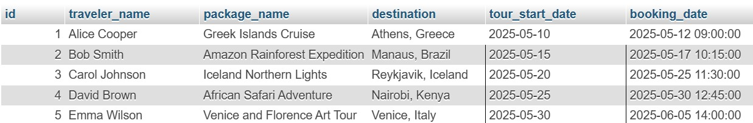
SAMPLE SQL QUERIES:
2. Retrieve travelers who booked for the Tour after its start date.
SELECT uc.id, uc.name AS traveler_name, tp.name AS package_name, tp.destination, to2.tour_date AS tour_start_date, to2.datentime AS booking_date FROM tour_order to2 JOIN user_cred uc ON to2.user_id = uc.id JOIN tour_packages tp ON to2.package_id = tp.package_id WHERE to2.datentime > to2.tour_date ORDER BY to2.datentime;
OUTPUT:

Slide 30
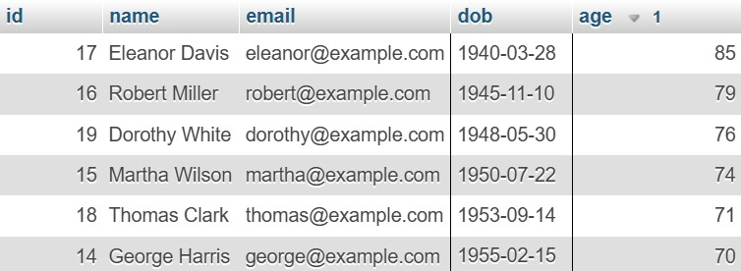
SAMPLE SQL QUERIES:
3. Retrieve the travelers who are senior citizens (>=60)-- Assuming current date is April 24, 2025
SELECT id, name, email, dob, TIMESTAMPDIFF(YEAR, dob, '2025-04-24') AS age FROM user_cred WHERE TIMESTAMPDIFF(YEAR, dob, '2025-04-24') >= 60 ORDER BY age DESC;
OUTPUT:

Slide 31
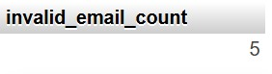
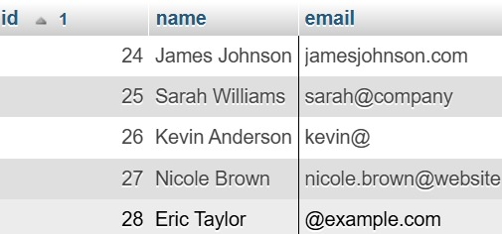
SAMPLE SQL QUERIES:
4. Count travelers having an invalid email ID
Valid emails should have "@" anywhere after the first character and should end with ".com“
SELECT COUNT(*) AS invalid_email_count FROM user_cred WHERE email NOT REGEXP '^.+@.+\\.com$’;
Bonus: List the invalid emails for verification
SELECT id, name, email FROM user_cred WHERE email NOT REGEXP '^.+@.+\\.com$’ ORDER BY id;
OUTPUT:

Slide 32
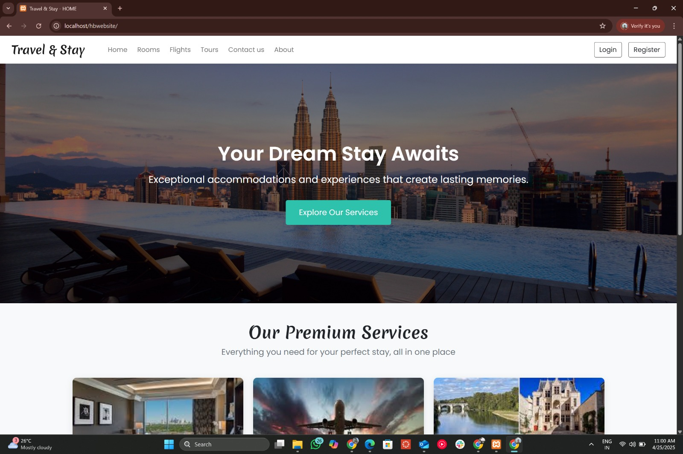
Website Layout

Slide 33

Let’s Travel (DEMO)

Slide 34
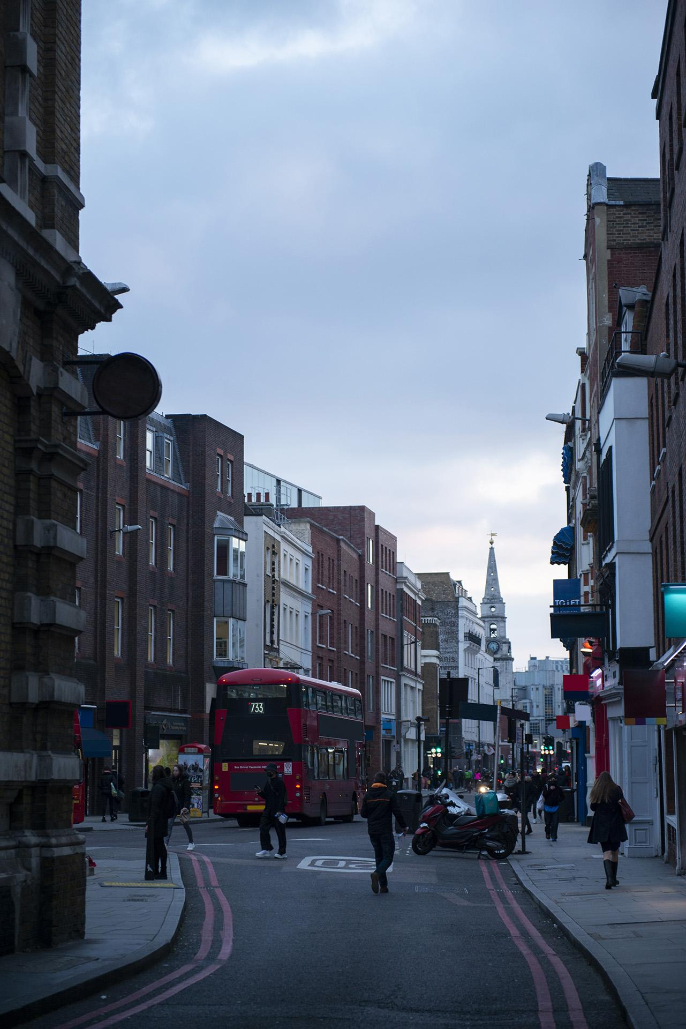
THANK YOU

